Slide 1

Chapter Five
Queue
Notes:
This lecture introduces queues. The presentation also shows two common ways of implementing a queue of integers.

Slide 2
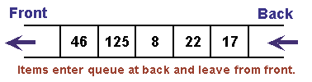
Queue
    Abstract data type: Queue
Many times, we use a list in a way where we always add to the end, and always remove from the front.
The first element put into the list will be the first element we take out of the list:
  First-In, First-Out ("FIFO")
Queue: a more restricted List with the following constraints:
  Elements are stored by order of insertion from front to back.
  Items can only be added to the back of the queue.
  Only the front element can be accessed or removed.
Goal: every operation on a queue should be O(1).

Slide 3
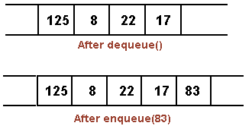
Queue … (continued)
Operations on a queue
Offer or enqueue: add an element to the back.
Remove or dequeue: remove and return the element at the front.
peek: return (but not remove) front element:
  peek on an empty queue returns null.
Other operations: isEmpty, size.
Queue features
ORDERING: maintains order elements were added (new elements are added to the end by default).

Slide 4
Queue … (continued)
OPERATIONS:
  Add element to end of list ('offer' or 'enqueue').
  Remove element from beginning of list ('remove' or 'dequeue') examine element at beginning of list ('peek').
  Clear all elements/Initialize()
      Initialize the queue to be empty
  isFull():
      Determine if queue is full or not. A Boolean operation needed for static queues. Returns true if the queue is full. Otherwise, returns false.

Slide 5
Queue … (continued)
  isEmpty():
      Determine whether queue is empty or not.
      A Boolean operation needed for all queues . Returns
      true if the queue is empty. Otherwise, returns false.
    display():
      If the queue is not empty then retrieve all
      elements.
  getsize().
      Determine the number of elements in the
      queue
  All of these operations are efficient! O(1).

Slide 6
The Queue Operations
A queue is like a line of people waiting for a bank teller. The queue has a front and a rear.
$ $
Rear
Front

Slide 7
The Queue Operations
New people must enter the queue at the rear. it is usually called an enqueue operation.
$ $
Front
Rear

Slide 8
The Queue Operations
When an item is taken from the queue, it always comes from the front. it is usually called a dequeue operation.
$ $
Front
Rear
Notes:
When an item is removed from a queue, the removal occurs at the front.

Slide 9
Array Implementation of Queue

Slide 10
A queue can be implemented with an array, as shown here.
For example, this queue contains the integers 4 (at the front), 8 and 6 (at the rear).
[ 0 ]
[1]
[ 2 ]
[ 3 ]
[ 4 ]
[ 5 ]
. . .
4 | 8 | 6
An array of integers to implement a queue of integers
We don't care what's in
this part of the array.
Notes:
Just like our stack implementation in the previous chapter, one way to implement a queue is to store the elements in an array.

Slide 11
Simple Array Implementation of Queue
The easiest implementation also keeps track of the number of items in the queue (Queue Size) and the index of the first element (at the front of the queue), the last element (at the rear).
3
size
0
Front
2
Rear
[ 0 ]
[1]
[ 2 ]
[ 3 ]
[ 4 ]
[ 5 ]
. . .
4
8
6
Front
Rear
Notes:
The easiest implementation also keeps track of three numbers. The size could be as small as zero or as large as the number of items in the array. The index of the front element is stored in the first member variable. The front item in the queue is at that index of the array. The next item is after the first one and so on until the rear of the queue that occurs at the index stored in a member variable called last.

Slide 12
A Dequeue Operation
When an element leaves the queue, size is decremented, and front changes, too
2
size
1
Front
2
Rear
[ 0 ]
[1]
[ 2 ]
[ 3 ]
[ 4 ]
[ 5 ]
. . .
4
8
6
Front
Rear
Notes:
This shows how the member variables change when an item leaves the queue.

Slide 13
An Enqueue Operation
When an element enters the queue, size is incremented, and rear changes, too
3
size
1
Front
3
Rear
[ 0 ]
[1]
[ 2 ]
[ 3 ]
[ 4 ]
[ 5 ]
. . .
8
6
2
Front
Rear
Notes:
And this shows how the member variables change when a new item enters the queue. For a fixed size array, a new item may enter only if the current size of the queue is less than the size of the array. For a dynamic array, we could increase the size of the array when the queue grows beyond the current array size.

Slide 14
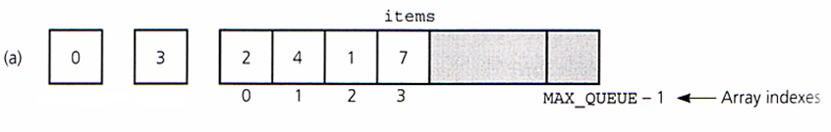
Array Based Implementation
Array: items[]
Variables:
  front
  rear
  MAX_QUEUE
front
rear

Slide 15
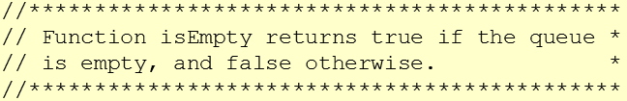
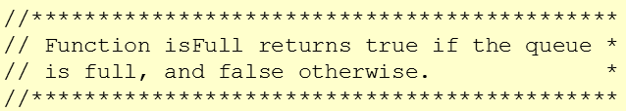
Array Based Implementation
………
int NumArray[];
int MAX_SIZE;
int FRONT= -1;
int REAR= -1;
int QUEUESIZE=0;
………
bool isEmpty()
{
if (QUEUESIZE==0)
return true;
else
return false;
}
bool isFull()
{
if (REAR<MAX_SIZE-1)
return false;
else
return true;
}

Slide 16
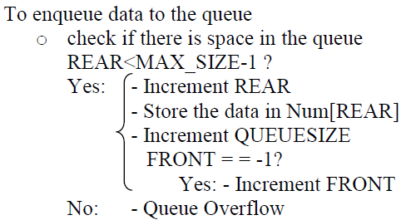
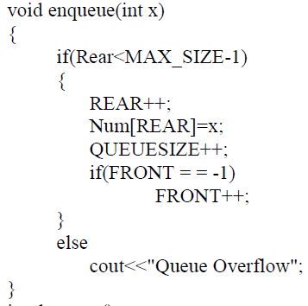
Array Based Implementation: Enqueue
Algorithm
Implementation

Slide 17
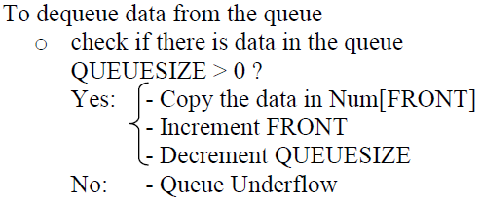
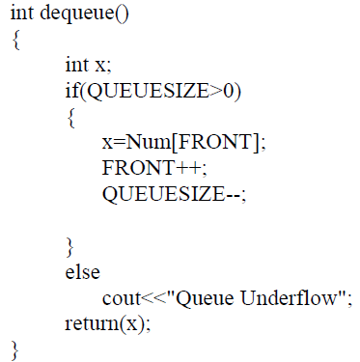
Array Based Implementation: Dequeue
Algorithm
Implementation

Slide 18
Circular Array Implementation of Queues
A problem with simple arrays is we run out of space even if the queue never reaches the size of the array.
Thus, circular arrays can be used to solve this problem.
    Freed spaces are re-used to store data

Slide 19
Circular Array Implementation of Queues…
There is special behaviour at the end of the array. For example, suppose we want to add a new element to this queue, where the last index is [5]:
3
size
3
Front
5
Rear
[ 0 ]
[1]
[ 2 ]
[ 3 ]
[ 4 ]
[ 5 ]
2
6
1
Front
Rear
Notes:
An array implementation of a queue must have special behavior when the rear of the queue reaches the end of the array. In this example, suppose we want to add the number 4 to the queue. We can do so…

Slide 20
An Enqueue Operation
The new element goes at the front of the array (if that spot isn’t already used):
4
size
3
Front
0
Rear
[ 0 ]
[1]
[ 2 ]
[ 3 ]
[ 4 ]
[ 5 ]
4
2
6
1
Rear
Front
Notes:
…by putting it at location 0 (if that location is not already used).

Slide 21
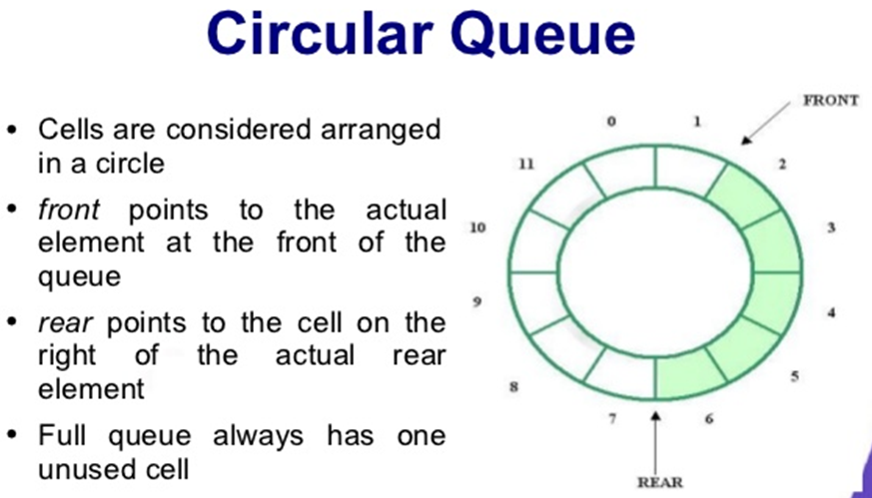

Slide 22
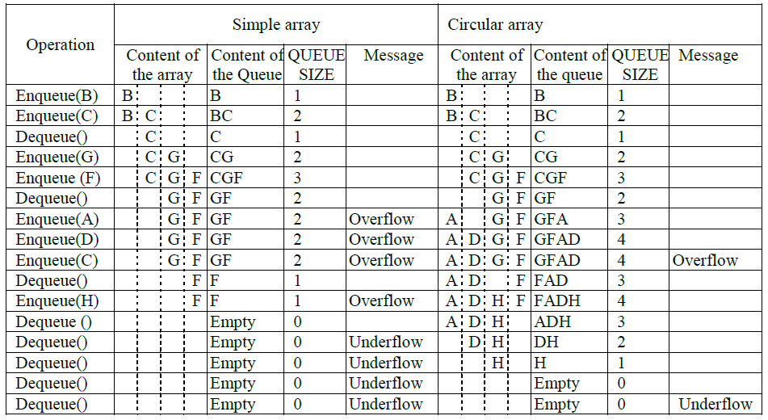
Example: Consider a queue with MAX_SIZE = 4

Slide 23
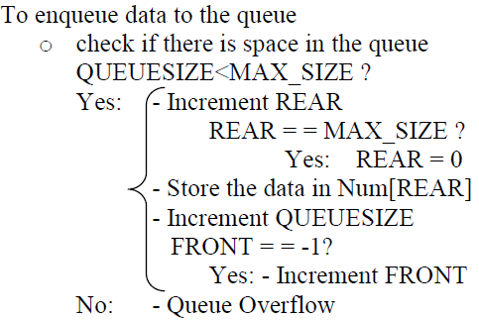
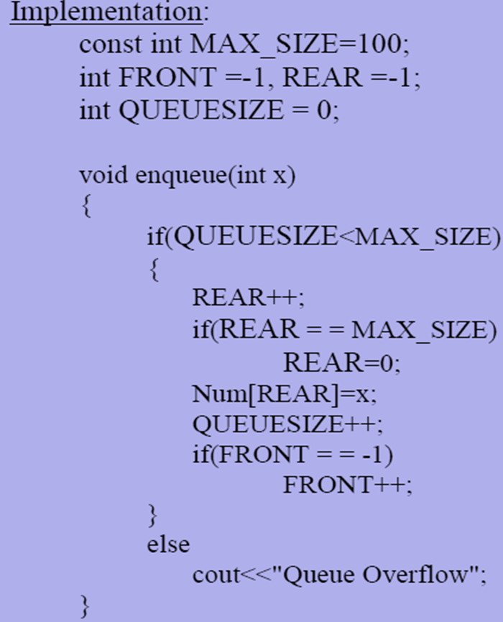
Algorithm and Implementation: enqueue

Slide 24
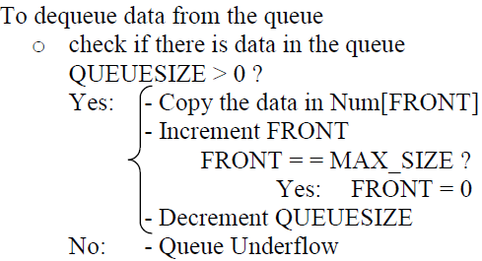

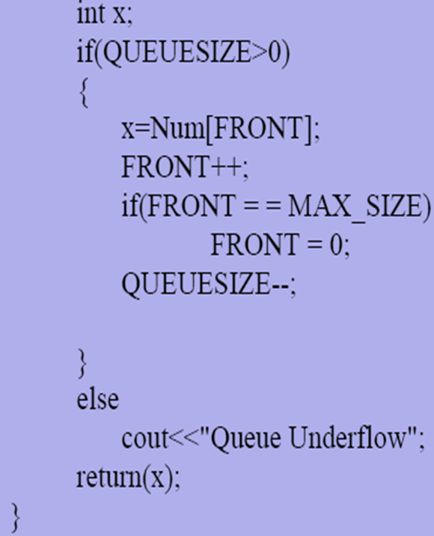
Algorithm and Implementation: dequeue

Slide 25
Linked List Implementation
A queue can also be implemented with a linked list with both a head (start) and a tail (end) pointer.
Enqueue:- is inserting a node at the end of a linked list.
Dequeue:- is deleting the first node in a linked list.
13
10
15
null
head_ptr
tail_ptr
Implementation – see the linked list adding at the end and deleting at the start example from the previous lectures.
Notes:
A linked list can also be used to implement a queue, but we must maintain both a head and a tail pointer because we need access to both the front and the rear of the queue.

Slide 26
Different Types of Queue

Slide 27
Deque (pronounced as Deck)
Is a Double Ended Queue.
Insertion and deletion can occur at either end.
Has the following basic operations:
EnqueueFront:– inserts data at the front of a list.
DequeueFront:– deletes data at the front of a list.
EnqueueRear:– inserts data at the end of a list.
DequeueRear:– deletes data at the end of a list.

Slide 28
Deque (pronounced as Deck)…..
Implementation is similar to that of queue.
Is best implemented using doubly linked list.
Front
Rear
EnqueueFront
DequeueRear
EnqueueRear
DequeueFront

Slide 29
Priority Queue
Is a queue where each data has an associated key that is provided at the time of insertion.
Dequeue operation deletes data having highest priority in the list.
One of the previously used dequeue or enqueue operations has to be modified.

Slide 30
Example:
Consider the following queue of persons where females have higher priority than males (gender is the key to give priority).
Abebe
Alemu
Aster
Belay
Kedir
Meron
Yonas
Male
Male
Female
Male
Male
Female
Male
Dequeue()- deletes Aster.
Abebe
Alemu
Belay
Kedir
Meron
Yonas
Male
Male
Male
Male
Female
Male

Slide 31
Dequeue()- deletes Meron
Abebe
Alemu
Belay
Kedir
Yonas
Male
Male
Male
Male
Male
Now the queue has data having equal priority and dequeue operation deletes the front element like in the case of ordinary queues.
Dequeue():- deletes Abebe

Slide 32
Dequeue():- deletes Alemu
Thus, in the above example the implementation of the dequeue operation need to be modified.
Demerging Queues:
Is the process of creating two or more queues from a single queue.
Used to give priority for some groups of data
Belay
Kedir
Yonas
Male
Male
Male

Slide 33
Example: The following two queues can be created from the above priority queue.
Aster
Meron
Abebe
Alemu
Belay
Kedir
Yonas
Female
Female
Male
Male
Male
Male
Male
Algorithm:
create empty females and males queue
while (PriorityQueue is not empty)
{
Data=DequeuePriorityQueue();//delete data at the front
if(gender of Data is Female)
EnqueueFemale(Data);
else
EnqueueMale(Data);
}

Slide 34
Merging Queues:
Is the process of creating a priority queue from two or more queues.
The ordinary dequeue implementation can be used to delete data in the newly created priority queue.

Slide 35
Example: The following two queues (females queue has higher priority than the males queue) can be merged to create a priority queue.
Aster
Meron
Abebe
Alemu
Belay
Kedir
Yonas
Female
Female
Male
Male
Male
Male
Male
Aster
Meron
Abebe
Alemu
Belay
Kedir
Yonas
Female
Female
Male
Male
Male
Male
Male

Slide 36
Algorithm:
create an empty priority queue
while(FemalesQueue is not empty)
EnqueuePriorityQueue(DequeueFemalesQueue());
while(MalesQueue is not empty)
EnqueuePriorityQueue(DequeueMalesQueue());

Slide 37
Example 2
The data with the largest element with higher priority.
Dequeue() A will be selected
Dequeue() B >>
Dequeue() C >>
Dequeue() D >>
A B C F E D H
40 30 25 15 18 20 12

Slide 38
Application of Queues
Access to shared resources (Example: printer)
Print()
{
EnqueuePrintQueue(Document)
}
EndOfPrint()
{
DequeuePrintQueue()
}
Disk Driver:-maintains a queue of disk input/output requests.

Slide 39
Application of Queues….
Task scheduler in multiprocessing system maintains priority queues of processes.
Telephone calls in a busy environment maintains a queue of telephone calls.
Simulation of waiting line - maintains a queue of persons.

